Slide 1





Unveil the MOSH &MOAH dimensionality by multidimensional chromatographic techniques
Giorgia Purcaro, Aleksandra Gorska, Paula Albendea
Gembloux Agro Bio-Tech, University of Liège, Belgium
gpurcaro@uliege.be

Slide 2
Unveil the MOSH &MOAH dimensionality by multidimensional chromatographic techniques
A GAC perspective
Giorgia Purcaro, Aleksandra Gorska, Paula Albendea
Gembloux Agro Bio-Tech, University of Liège, Belgium
gpurcaro@uliege.be

Slide 3
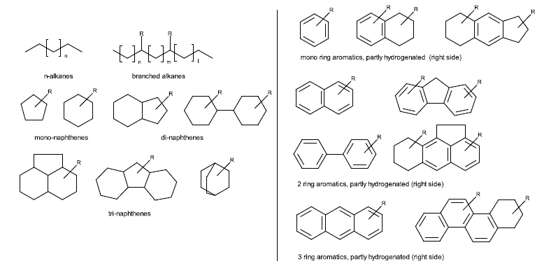

MINERAL OIL HYDROCARBONS (MOH): DEFINITION*
a wide range of products deriving from petroleum distillation fractions
MOSH
Mineral oil saturated hydrocarbons
MOAH
Mineral oil aromatic hydrocarbons
n-alkane
isoalkane
cycloalkane
Aromatic hydrocarbons, mainly alkylated

Slide 4
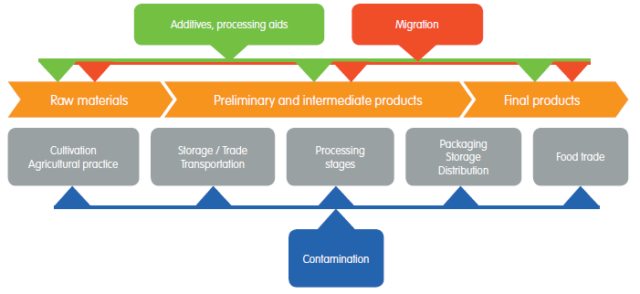

MINERAL OIL HYDROCARBONS (MOH): OCCURENCE

Slide 5

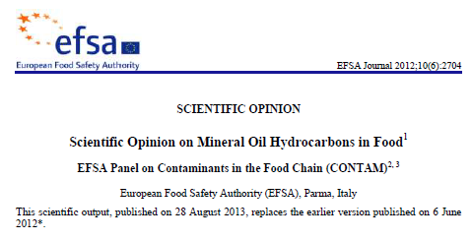
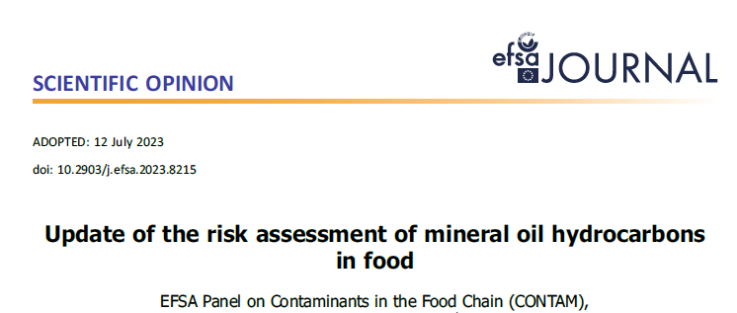
MOSH & MOAH: STATE-OF-THE ART
2012
2023
MOSH
MOAH
Generally considered of no concern at the concentration found.
genotoxicity of MOAH with ≥3 aromatic rings
in the absence of reliable toxicity data, the dietary exposure to 1–2 ring MOAH might raise a concern

Slide 6


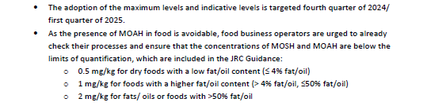
MINERAL OIL HYDROCARBONS (MOH)

Slide 7
MOSH & MOAH: STATE-OF-THE ART
2012
2023
MOSH
MOAH
Generation of further data for the refinement of the risk assessment is needed
Improvement of analytical methodology
for better characterisation of MOSH&MOAH and consistency in reporting
Generally considered of no concern at the concentration found.
genotoxicity of MOAH with ≥3 aromatic rings
in the absence of reliable toxicity data, the dietary exposure to 1–2 ring MOAH might raise a concern

Slide 8

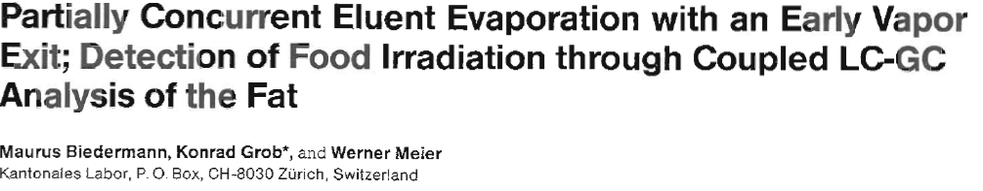
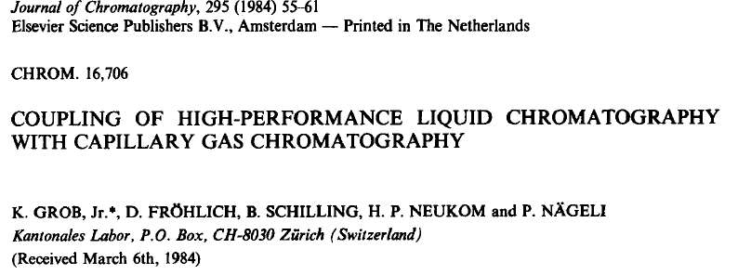
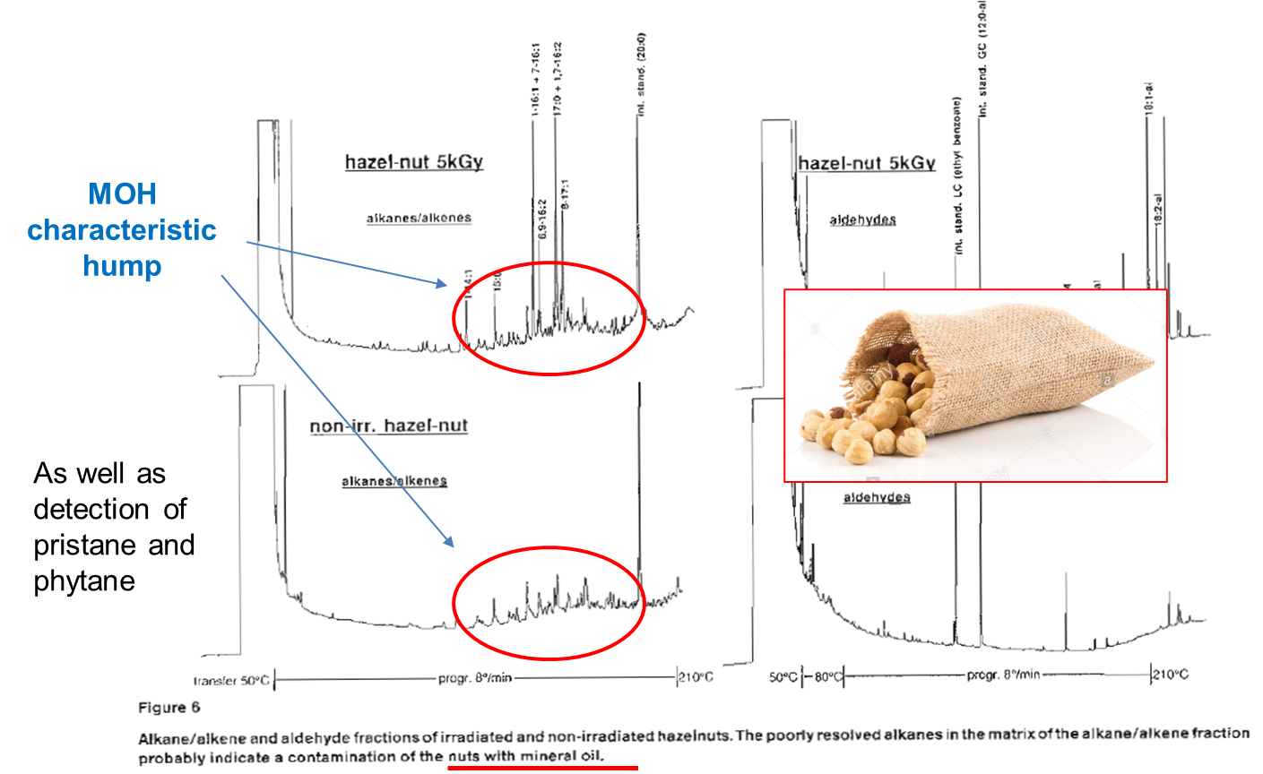
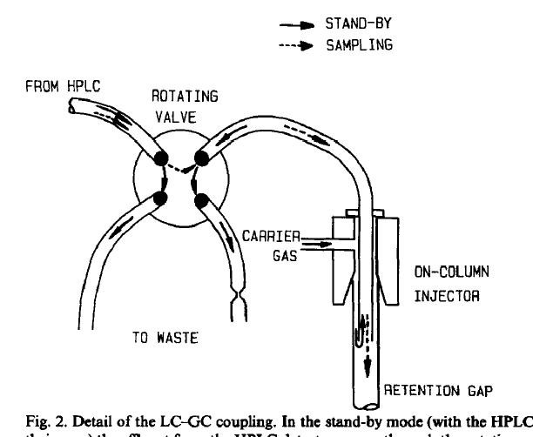
MOSH & MOAH: Analytical Determination
Historical perspective
MOH
LC-GC-FID
1989
J High Resol Chromatogr. 1989 12:591–598.
1984
J Chromatogr. 1984 295:55-61
Complex applications ↔ Advanced Routine

Slide 9
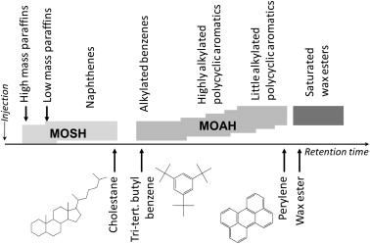

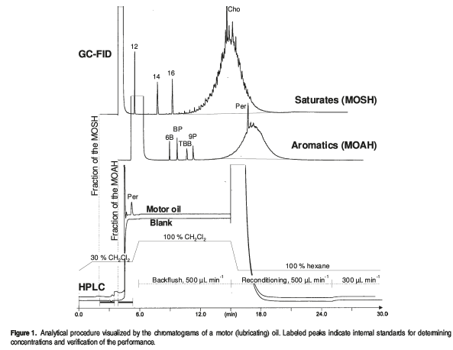
MOSH & MOAH: Analytical Determination
LC-GC-FID
+ C11, C13 and CyCy (cyclohexylcyclohexane)
C11/CyCy loss of volatiles
C13/CyCy possible coelution
CyCy quantification
+ 5B (pentyl benzene), 1MN (1-Me Na) and 2MN (2-Me Na)
5B loss of volatiles
1MN=2MN possible coelution/ quantification

Slide 10
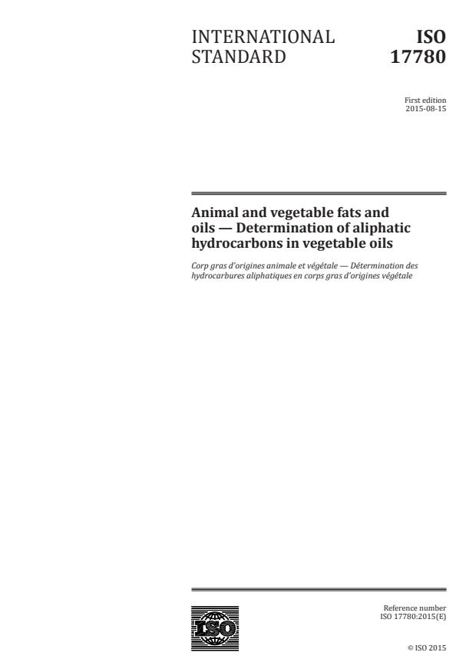
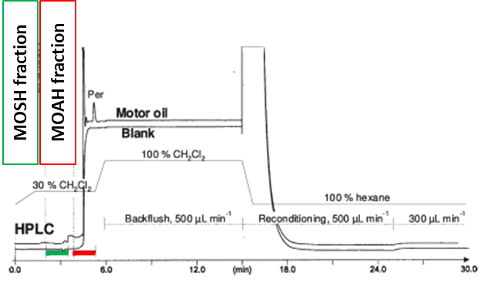
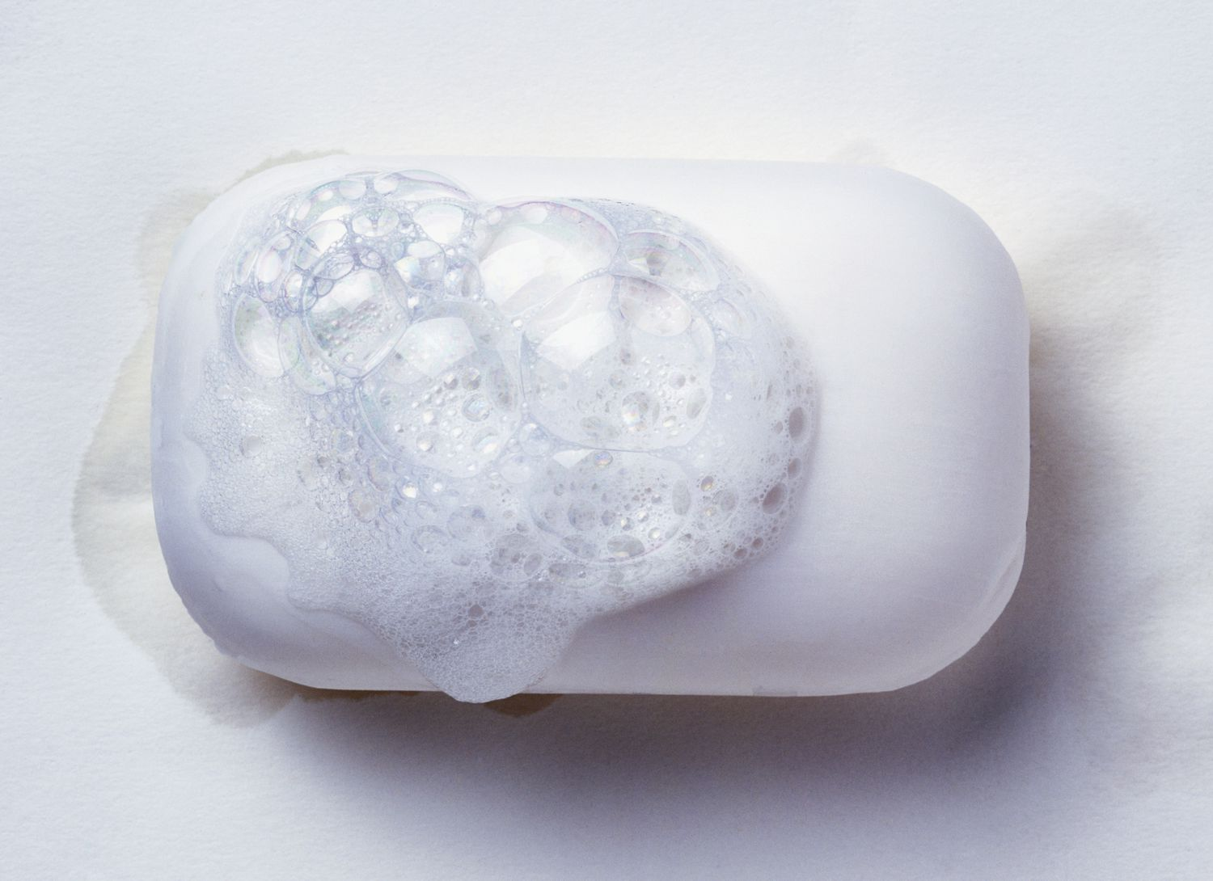
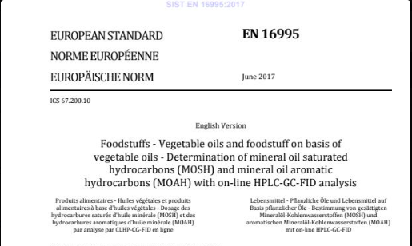
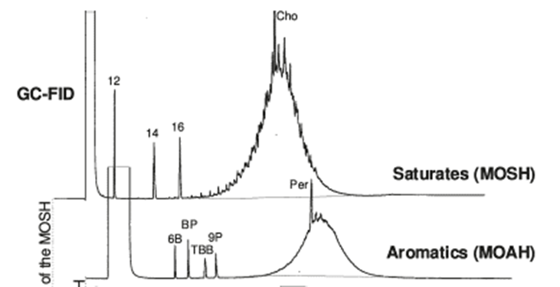
MOSH & MOAH: Analytical Determination
Sample dilution (e.g., fats and oil)
LC-GC-FID
LC
GC-FID

Slide 11
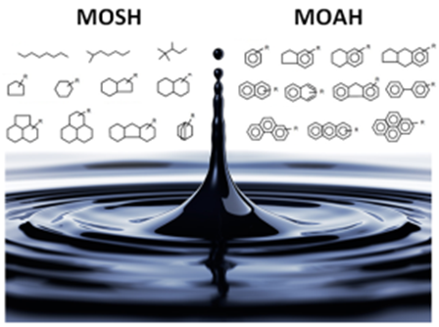
S
Select direct analytical technique
I
Integrate analytical processes and operations​
G
Generate as little waste as possible​
N
Never waste energy​
LC-GC-FID, no MS
I
Implement automation and miniaturization​
Partially Automated
F
Favor reagents from renewable sources​
GREEN CHEMISTRY
GREEN ANALYTICAL CHEMISTRY
I
Increase safety for the operator​
Online method
C
Carry out in-situ measurements​
A
Avoid derivation​
N
Note minimal sample number and size​
C
Choose multi‑analyte or multi‑parameter methods​
UCM
E
Eliminate or replace toxic reagents​
Notes:
1. S Direct analytical techniques should be applied to avoid
sample treatment.
2. N Minimal sample size and minimal number of samples are
goals.
3. C In situ measurements should be performed.
4. I Integration of analytical processes and operations saves
energy and reduces the use of reagents.
5. I Automated and miniaturized methods should be selected.
6. A Derivatization should be avoided.
7. G Generation of a large volume of analytical waste should be
avoided and proper management of analytical waste should
be provided.
8. C Multi-analyte or multi-parameter methods are preferred
versus methods using one analyte at a time.
9. N The use of energy should be minimized.
10. F Reagents obtained from renewable source should be preferred.
11. E Toxic reagents should be eliminated or replaced.

Slide 12
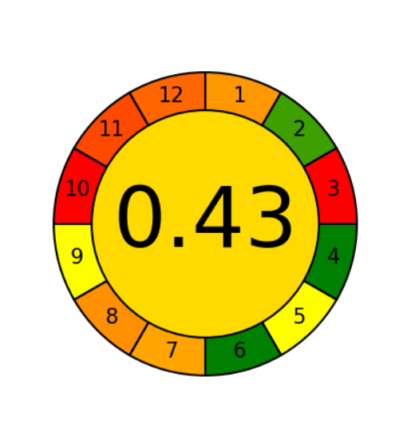
MOSH & MOAH: Analytical Determination
Sample dilution (e.g., fats and oil)
LC-GC-FID
LC
@Agree
Anal. Chem. 2020, 92, 10076−10082
Working range starting from 10 mg/kg
Max LC loading : 20 mg of fat
GC-FID
SENSITIVITY

Slide 13
MOSH & MOAH: Analytical Determination
EXTRACTION/ENRICHMENT
LC-GC-FID
LC
Extraction and enrichment simultaneous
higher sensitivity, less frequent washing of the LC column.
Higher extraction yield
GC-FID

Slide 14
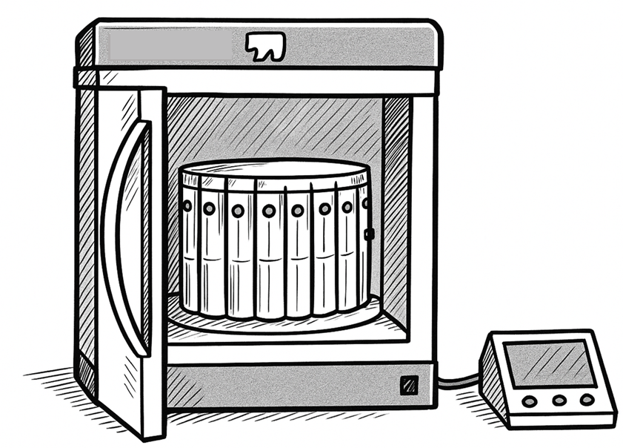
MOSH & MOAH: Analytical Determination
EXTRACTION/ENRICHMENT
LC-GC-FID
LC
Extraction and enrichment simultaneous
higher sensitivity, less frequent washing of the LC column.
Higher extraction yield
GC-FID
Microwave-assisted saponification and extraction (MASE) method

Slide 15
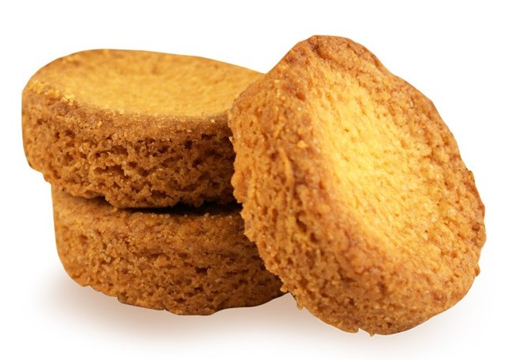
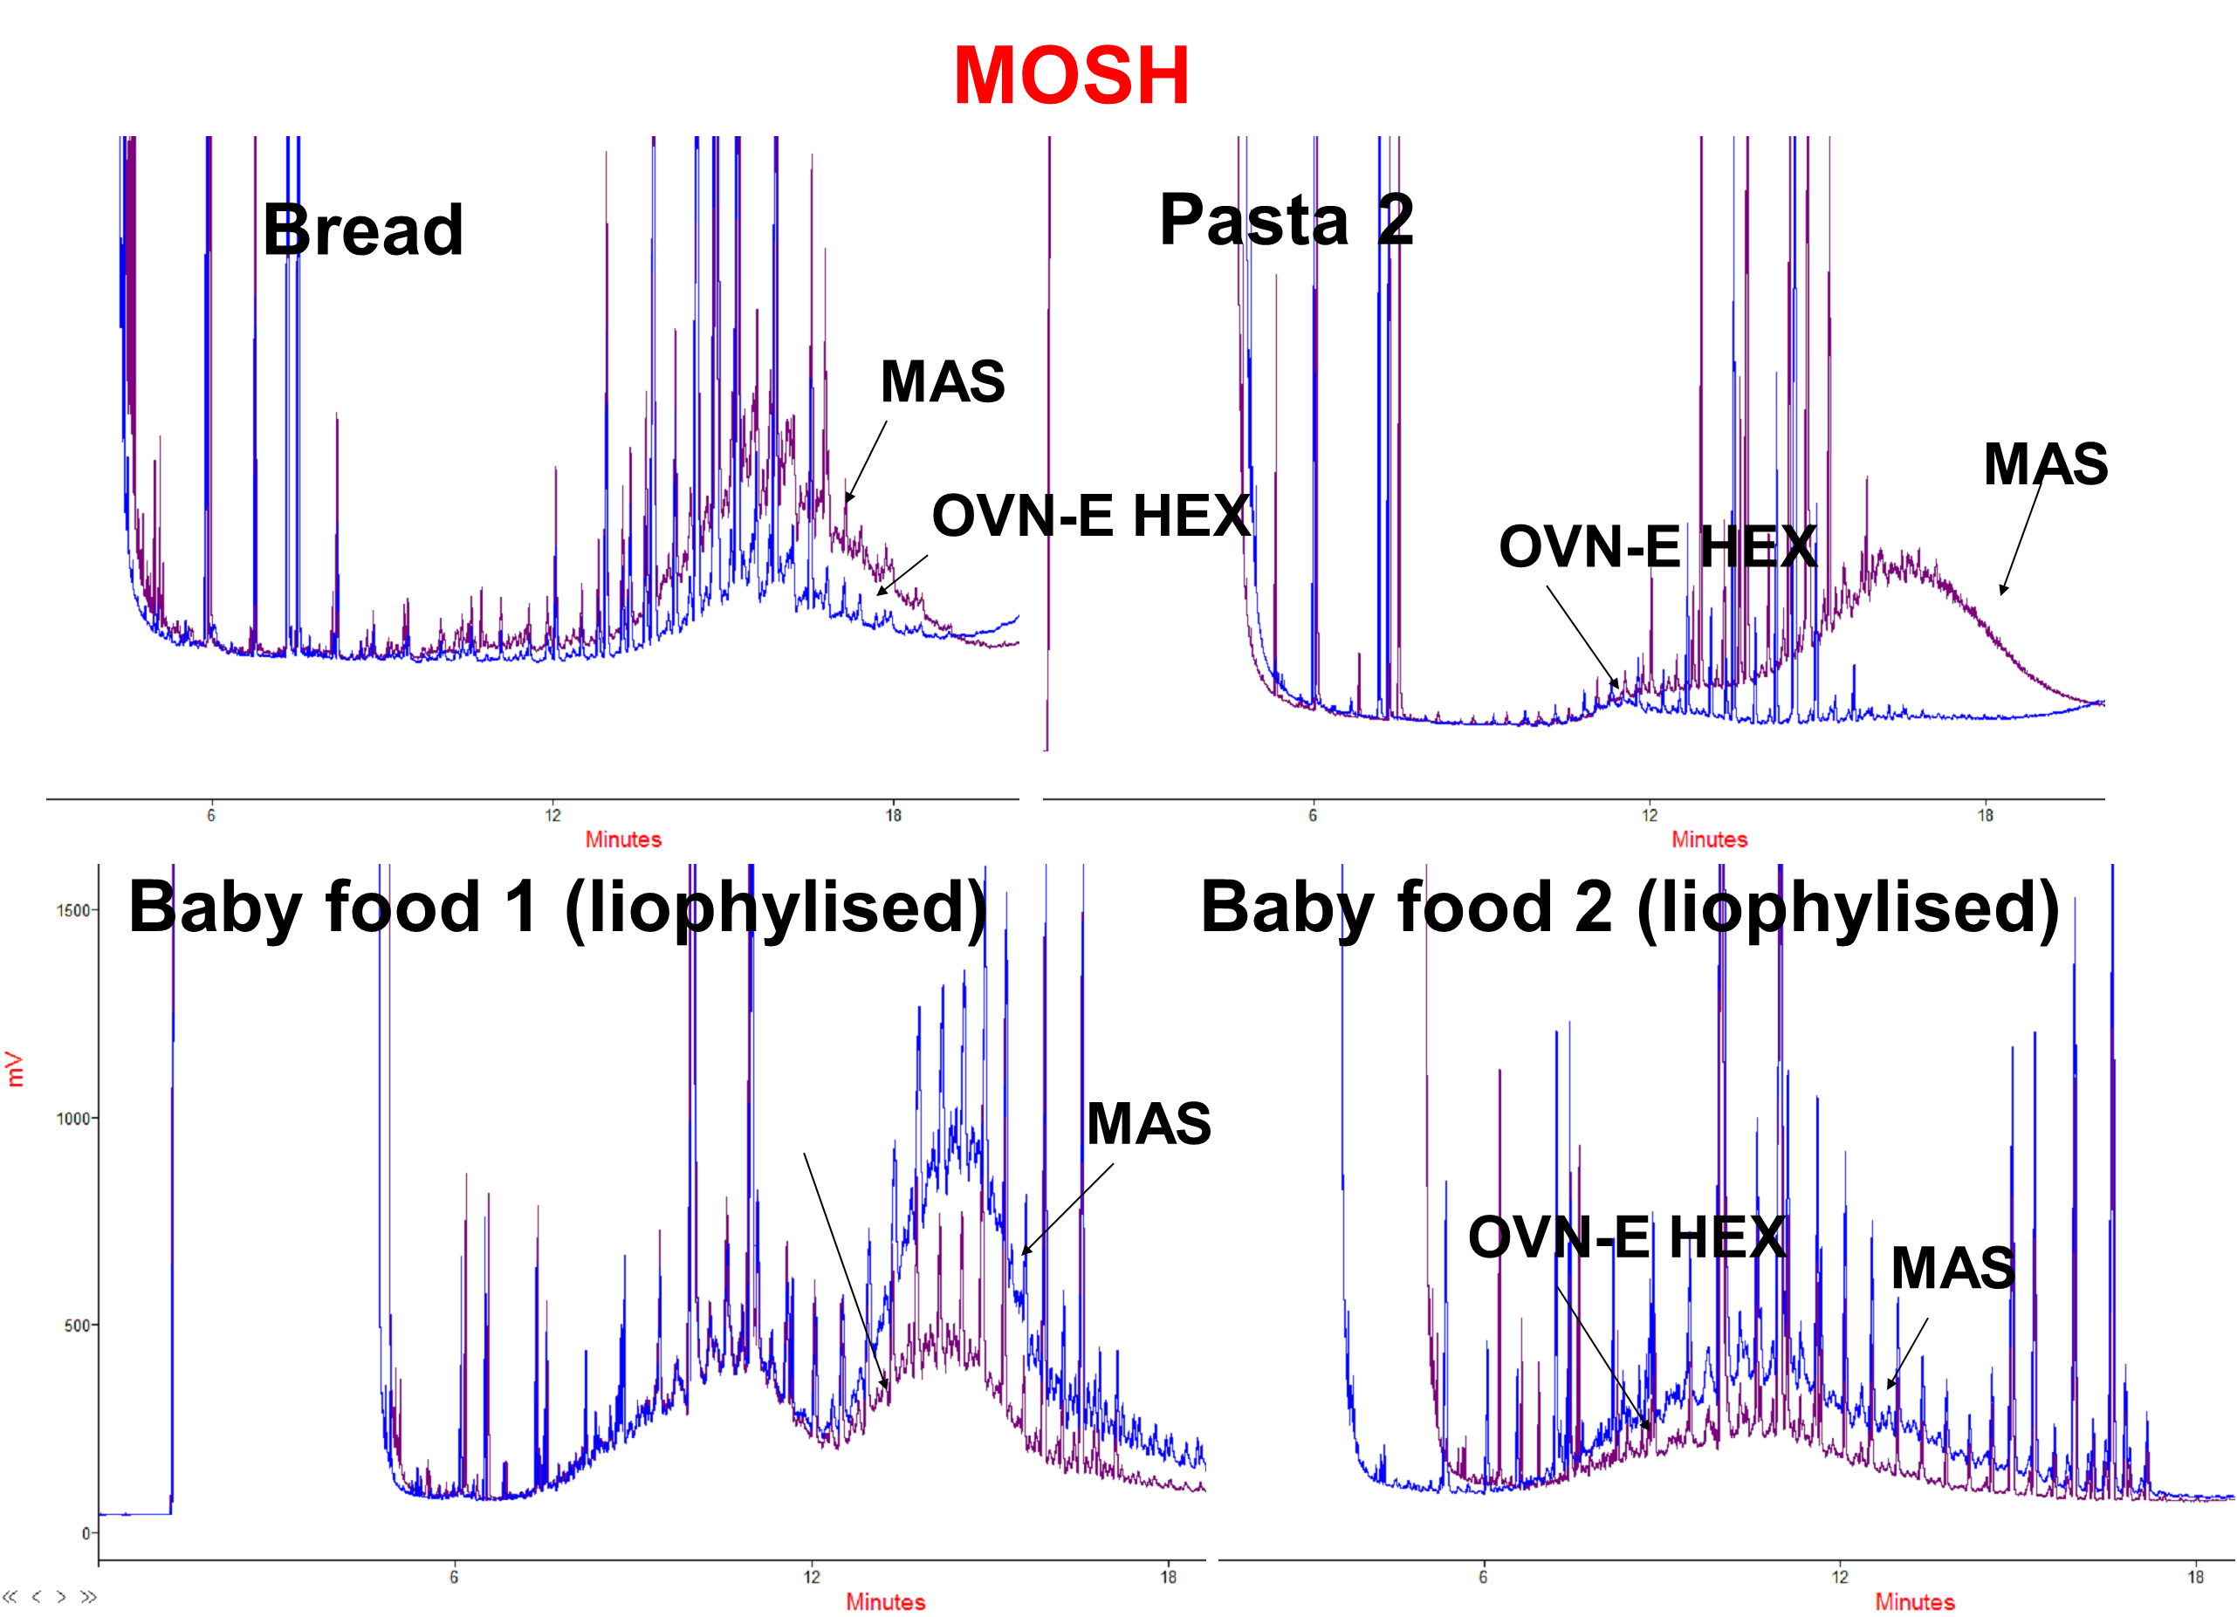
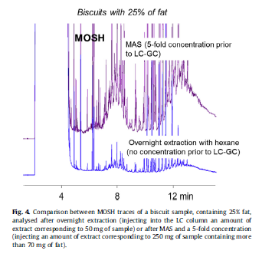
MOSH & MOAH: Analytical Determination
Microwave-assisted saponification and extraction (MASE) method
MAS vs OVN-E (hexane)
5 × SENSITIVITY
More accurate information
Moret S., Scolaro M., Barp L., Purcaro G., Conte, L.S., Food Chem 196 (2016) 50-57

Slide 16
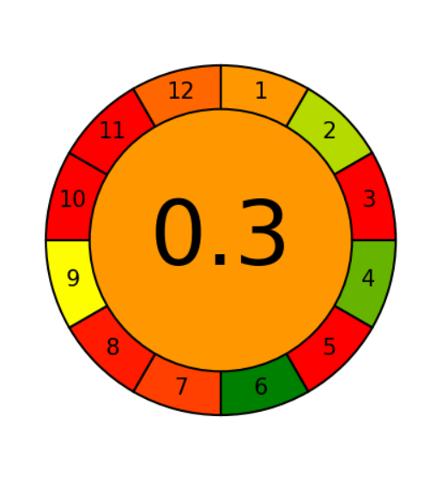
MOSH & MOAH: Analytical Determination
Sample dilution (e.g., fats and oil)
Working range starting from 10 mg/kg
Max LC loading : 20 mg of fat
LC-GC-FID
EXTRACTION/ENRICHMENT
LC-GC-FID
Sensitivity (2 mg/kg*)
Accuracy
*Depends on the initial content of fat
@Agree
Anal. Chem. 2020, 92, 10076−10082

Slide 17
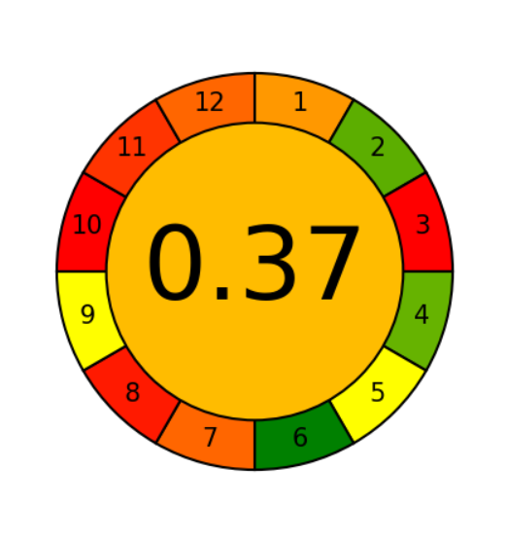
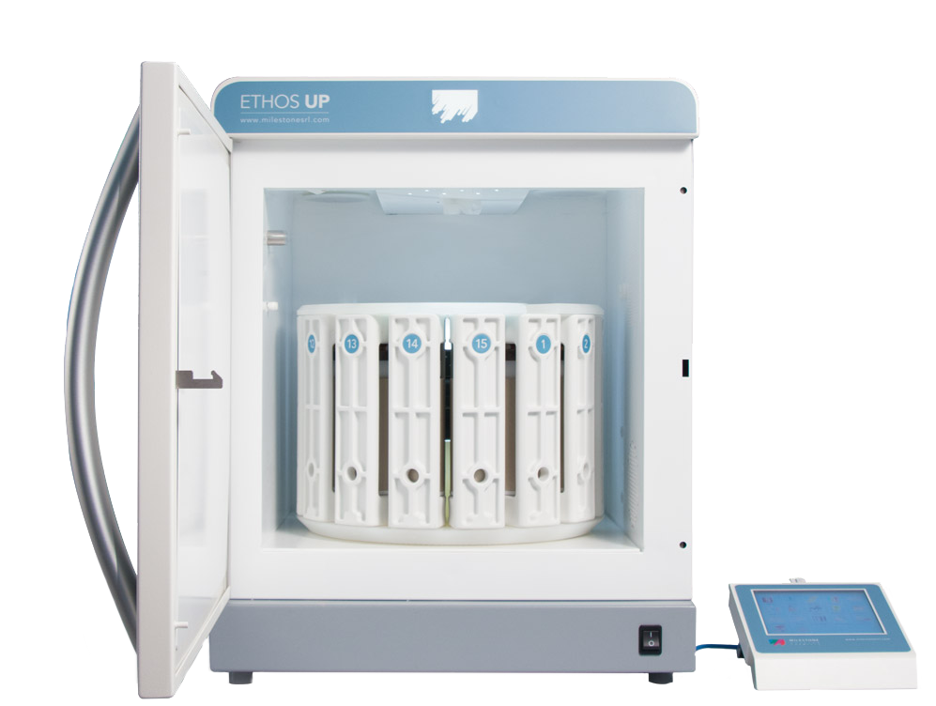
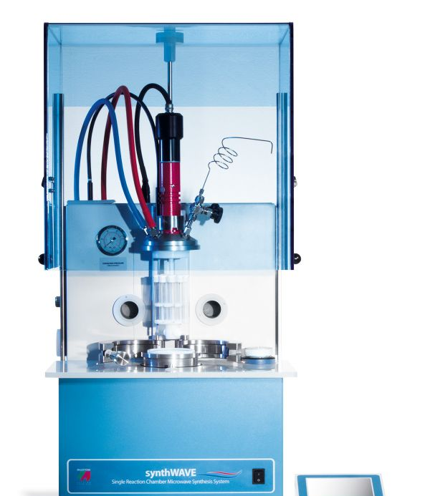
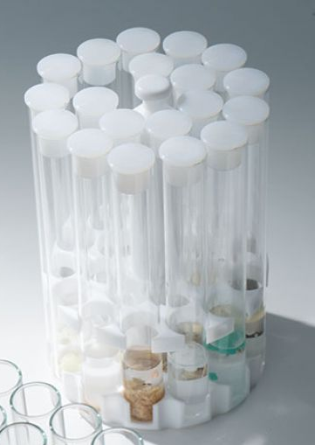
MOSH & MOAH: Analytical Determination
Sample dilution (e.g., fats and oil)
Working range starting from 10 mg/kg
Max LC loading : 20 mg of fat
LC-GC-FID
EXTRACTION/ENRICHMENT
LC-GC-FID
Sensitivity (2 mg/kg*)
Accuracy
*Depends on the initial content of fat
MINIATURIZATION
MASE applied for the meat:
5 g meat + 10 mL C6 + 10 mL KOH/(EtOH/H2O)
MASE: 5 min pre-heating, 120 °C 20 min
MASE miniaturized:
0.4 g meat + 2.5 mL C6 + 2.5 mL KOH/(EtOH/H2O)
MASE: 5 min pre-heating, 120 °C 20 min
Albendea P., Purcaro G., Food Chemistry 480 (2025) 143880
Albendea P., Gorska A., Purcaro G., Journal of Chromatography Open 8 (2025) 100267
Warning on representativeness!
@Agree
Anal. Chem. 2020, 92, 10076−10082

Slide 18
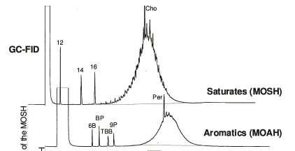
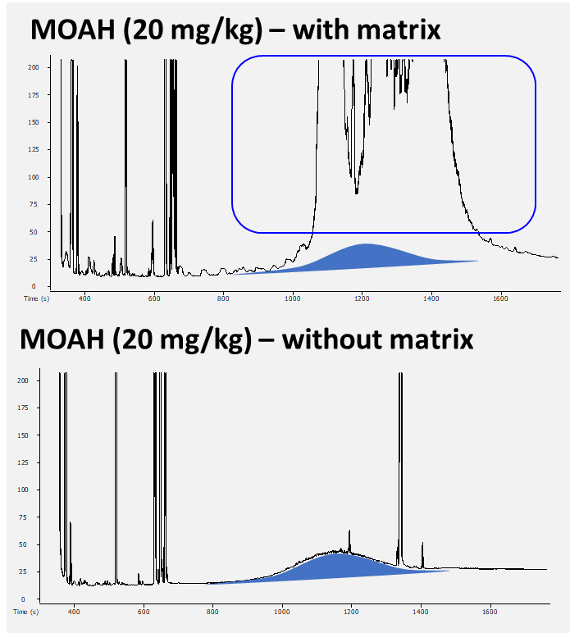
MOSH & MOAH: Analytical Determination
EXTRACTION/ENRICHMENT
LC-GC-FID
Sensitivity (2 mg/kg*)
Accuracy
*Depends on the initial content of fat
Microwave-assisted saponification and extraction (MASE) method
@Agree
Anal. Chem. 2020, 92, 10076−10082

Slide 19
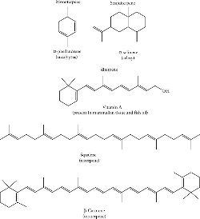
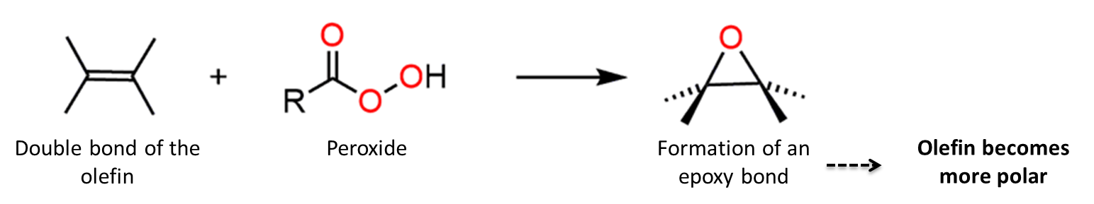

MOSH & MOAH: Analytical Determination
EXTRACTION/SAPONIFICATION
PURIFICATION
LC-GC-FID
LC
Microwave-assisted saponification and extraction (MASE) method
EPOXIDATION
GC-FID
ISO 20122:2024
Vegetable oils — Determination of mineral oil saturated hydrocarbons (MOSH) and mineral oil aromatic hydrocarbons (MOAH) with online-coupled high performance liquid chromatography-gas chromatography-flame ionization detection (HPLC-GC-FID) analysis — Method for low limit of quantification
Works rather well but also attacks MOAH due to their double bonds

Slide 20
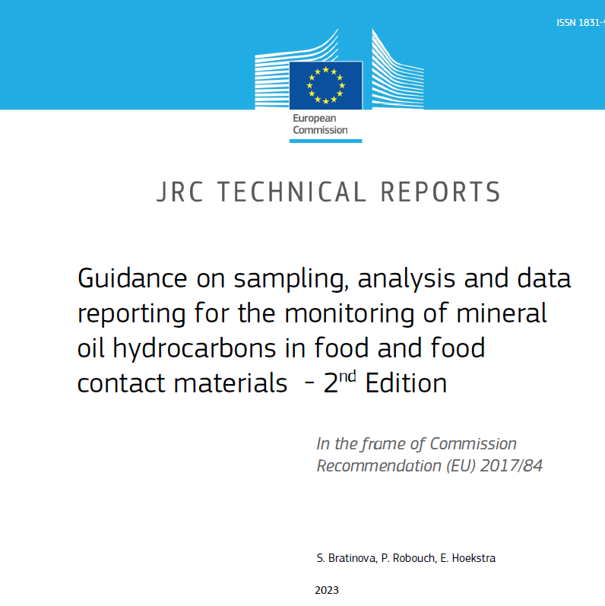
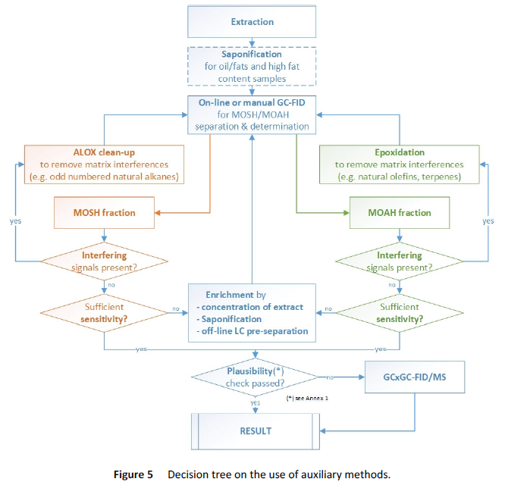
MOSH & MOAH: Analytical Determination
Need for matrix-tailored sample prep protocols
Sample Preparation
> 20% of uncertainty!
Data Interpretation
Data
Integration

Slide 21
S
Select direct analytical technique
I
Integrate analytical processes and operations​
G
Generate as little waste as possible​
N
Never waste energy​
LC-GC-FID, no MS
I
Implement automation and miniaturization​
Partially Automated
F
Favor reagents from renewable sources​
GREEN CHEMISTRY
GREEN ANALYTICAL CHEMISTRY
I
Increase safety for the operator​
Online method
C
Carry out in-situ measurements​
A
Avoid derivation​
N
Note minimal sample number and size​
C
Choose multi‑analyte or multi‑parameter methods​
UCM
E
Eliminate or replace toxic reagents​
Notes:
1. S Direct analytical techniques should be applied to avoid
sample treatment.
2. N Minimal sample size and minimal number of samples are
goals.
3. C In situ measurements should be performed.
4. I Integration of analytical processes and operations saves
energy and reduces the use of reagents.
5. I Automated and miniaturized methods should be selected.
6. A Derivatization should be avoided.
7. G Generation of a large volume of analytical waste should be
avoided and proper management of analytical waste should
be provided.
8. C Multi-analyte or multi-parameter methods are preferred
versus methods using one analyte at a time.
9. N The use of energy should be minimized.
10. F Reagents obtained from renewable source should be preferred.
11. E Toxic reagents should be eliminated or replaced.

Slide 22
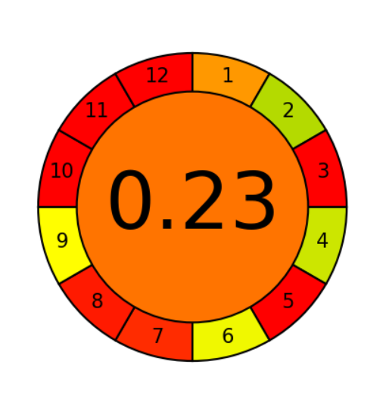
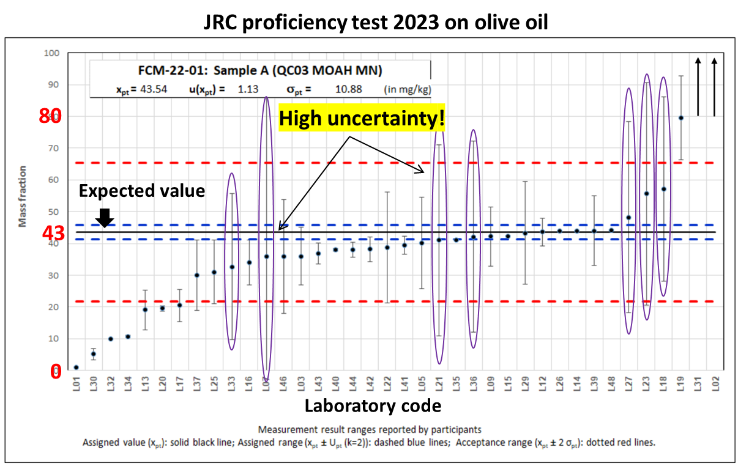
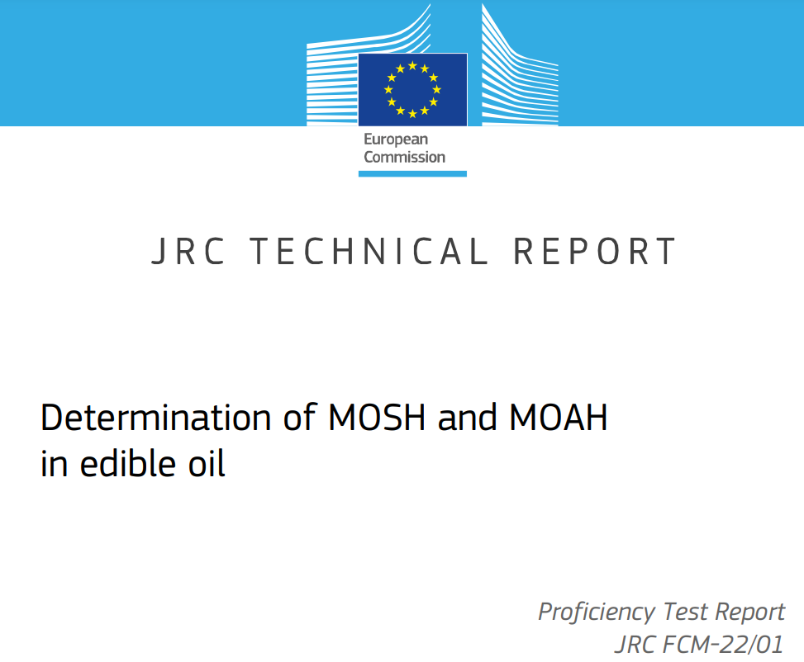
MOSH & MOAH: Analytical Determination
Sample dilution (e.g., fats and oil)
Working range starting from 10 mg/kg
Max LC loading : 20 mg of fat
LC-GC-FID
EXTRACTION/ENRICHMENT
LC-GC-FID
↑ Sensitivity (2 mg/kg*)
*Depends on the initial content of fat
EXTRACTION/SAPONIFICATION
PURIFICATION
LC-GC-FID
Sample
Preparation
Data
Interpretation
Uncertainty
Data
Integration
@Agree
Anal. Chem. 2020, 92, 10076−10082

Slide 23
MOSH & MOAH: Analytical Determination
Sample dilution (e.g., fats and oil)
Working range starting from 10 mg/kg
Max LC loading : 20 mg of fat
LC-GC-FID
EXTRACTION/ENRICHMENT
LC-GC-FID
↑ Sensitivity (2 mg/kg*)
*Depends on the initial content of fat
↑ Applicability
≈ Sensitivity
≈ ↑↓ Accuracy
EXTRACTION/SAPONIFICATION
PURIFICATION
LC-GC-FID
@Agree
Anal. Chem. 2020, 92, 10076−10082

Slide 24
MOSH & MOAH: Analytical Determination
The Source of Uncertainty
EXTRACTION/SAPONIFICATION
PURIFICATION
LC-GC-FID
LC
Microwave-assisted saponification and extraction (MASE) method
GC-FID
Sample
Preparation
Data
Interpretation
Data
Integration

Slide 25


MOSH & MOAH: Analytical Determination
EXTRACTION/SAPONIFICATION
PURIFICATION
LC-GC-FID
Data
Interpretation
Ideal profile
Data
Integration
NO MOAH
without MOSH
Same volatility range
Most probably not MOAH, but interferences
MOSH
~ 4 × MOAH
MOSH
MOAH
MOSH
MOAH
MOSH
MOAH

Slide 26
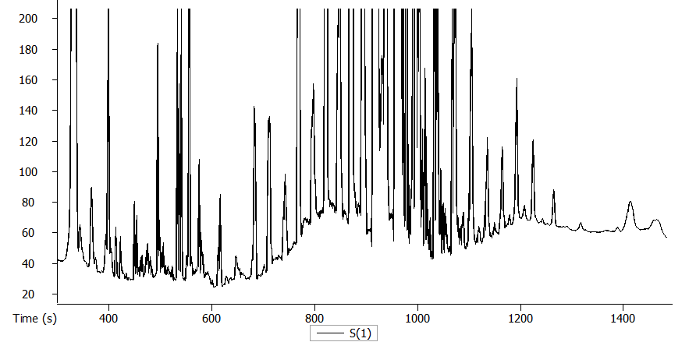
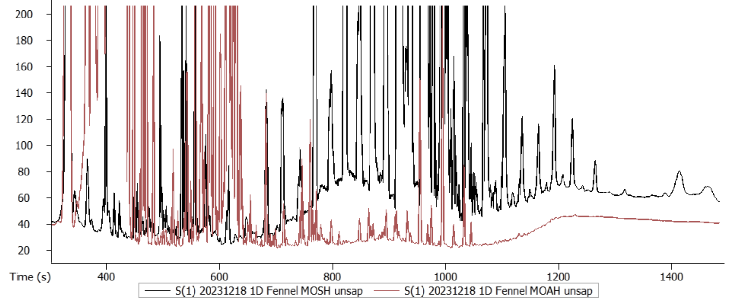
MOSH & MOAH: Analytical Determination
EXTRACTION/SAPONIFICATION
PURIFICATION
LC-GC-FID
Data
Interpretation
Ideal profile
Baseline
Riding peaks
Data
Integration
MOSH vs MOAH – No purification
MOSH
MOAH
MOSH
MOAH

Slide 27
MOSH & MOAH: Analytical Determination
EXTRACTION/SAPONIFICATION
PURIFICATION
LC-GC-FID
Data
Interpretation
Ideal profile
Baseline
Riding peaks
Data
Integration
Trimming or not the riding peaks? And how?
MOSH
MOAH

Slide 28
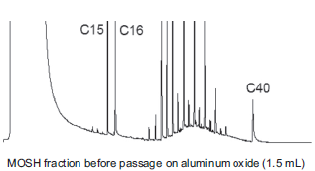
MOSH & MOAH: Analytical Determination
EXTRACTION/SAPONIFICATION
PURIFICATION
LC-GC-FID
Data
Interpretation
Ideal profile
Baseline
Riding peaks
Data
Integration
Trimming or not the riding peaks? And how?
Trim
NO Trim
Natural alkanes: primarily odd-chain in the ≥C₂₁
MO alkanes: no prevalence

Slide 29
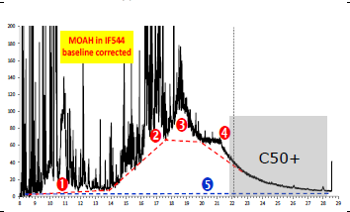
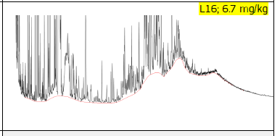
MOSH & MOAH: Analytical Determination
EXTRACTION/SAPONIFICATION
PURIFICATION
LC-GC-FID
Data
Interpretation
Ideal profile
Baseline
Riding peaks
Data
Integration
Trimming or not the riding peaks? And How?

Slide 30
MOSH & MOAH: Analytical Determination
EXTRACTION/SAPONIFICATION
PURIFICATION
LC-GC-FID
Data
Interpretation
Ideal profile
How to support the interpretation?
Data
Integration
GC×GC
N° of rings
Degree of alkylation

Slide 31
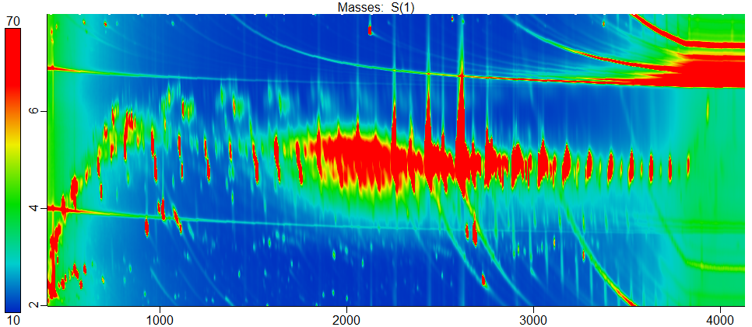
MOSH & MOAH: Analytical Determination
EXTRACTION/SAPONIFICATION
PURIFICATION
LC-GC-FID
Ideal profile
How to support the interpretation?
GC×GC
More accurate quantification

Slide 32
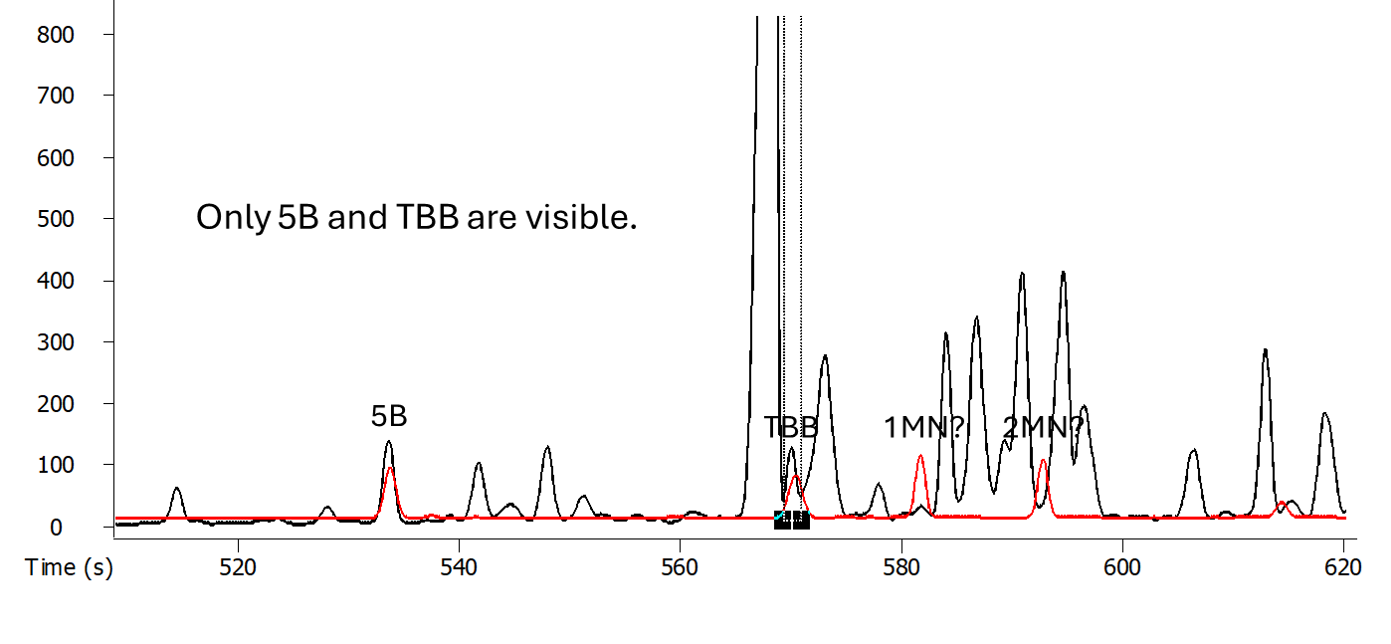
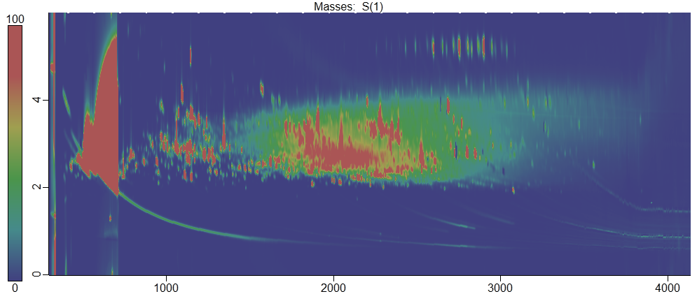
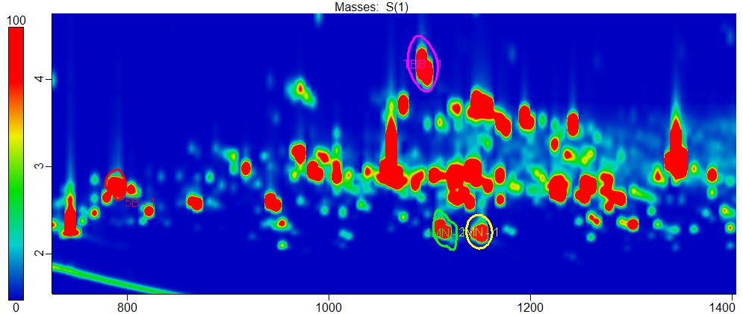
MOSH & MOAH: Analytical Determination
EXTRACTION/SAPONIFICATION
PURIFICATION
LC-GC-FID
Ideal profile
How to support the interpretation?
GC×GC
More accurate quantification
MOAH analysis by GC-FID
IS for quantification
MOAH analysis by GC×GC-FID
MOAH
Iss coeluted with interferences
→ impossible MOAH quantification

Slide 33
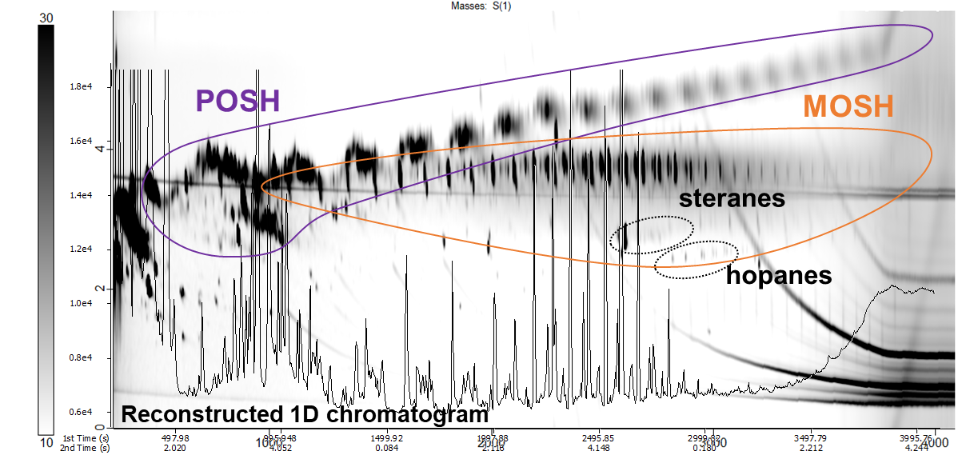
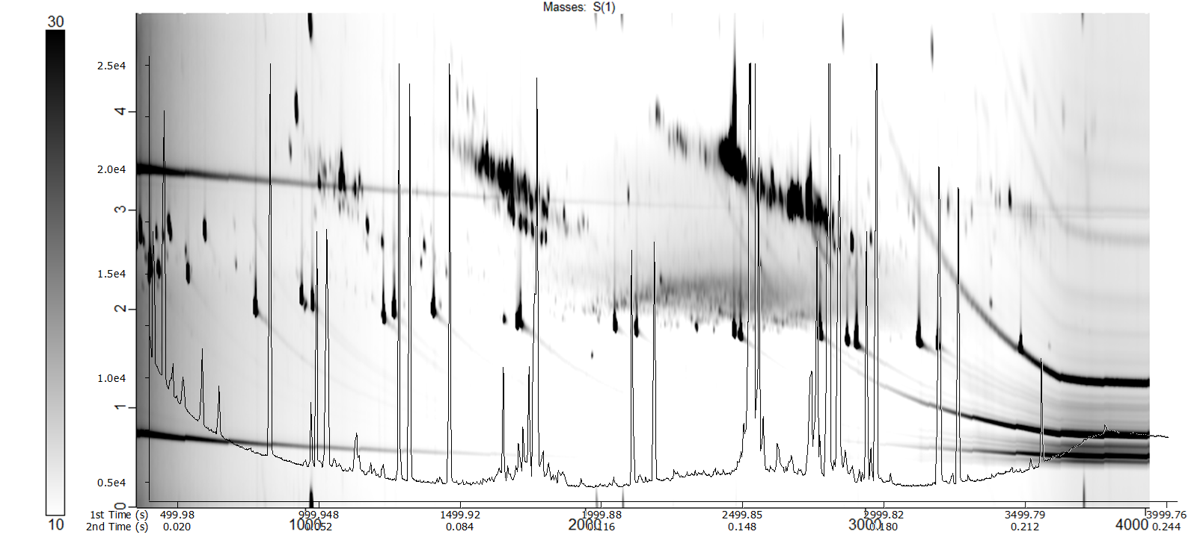
MOSH & MOAH: Analytical Determination
EXTRACTION/SAPONIFICATION
PURIFICATION
LC-GC-FID
Ideal profile
How to support the interpretation?
GC×GC
Easier interpretation
MOSH
MOAH

Slide 34
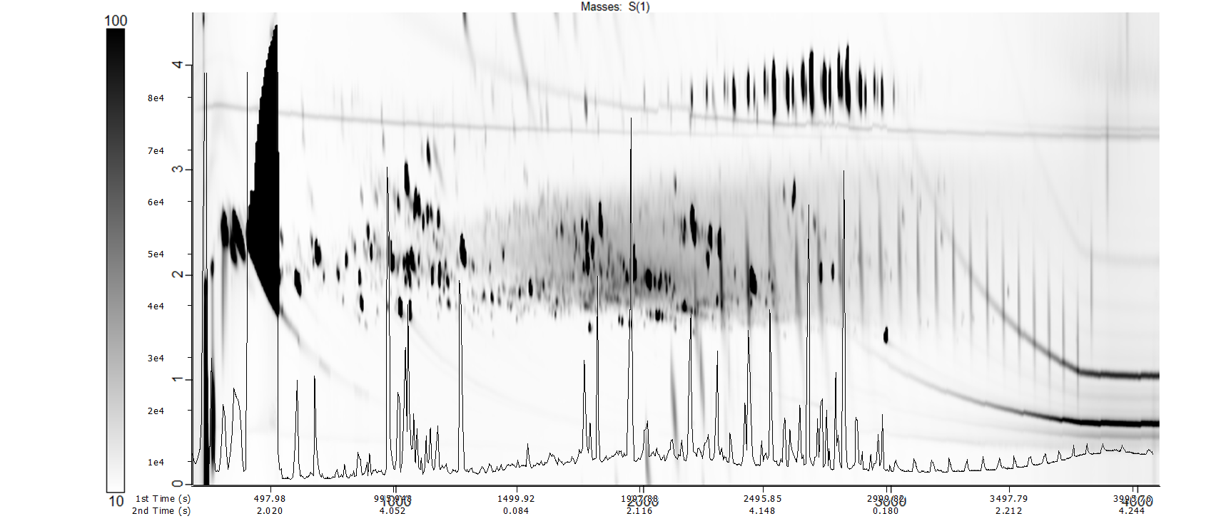
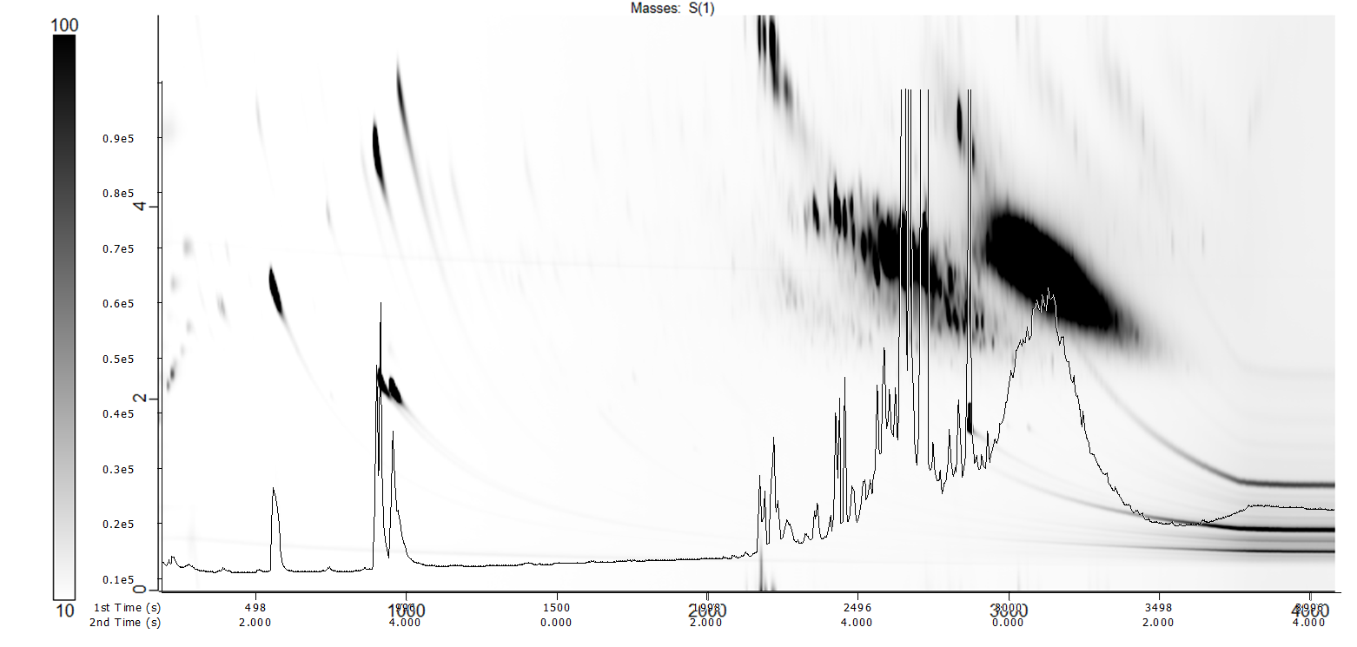
MOSH & MOAH: Analytical Determination
EXTRACTION/SAPONIFICATION
PURIFICATION
LC-GC-FID
Ideal profile
How to support the interpretation?
GC×GC
Easier interpretation
MOAH
MOAH

Slide 35
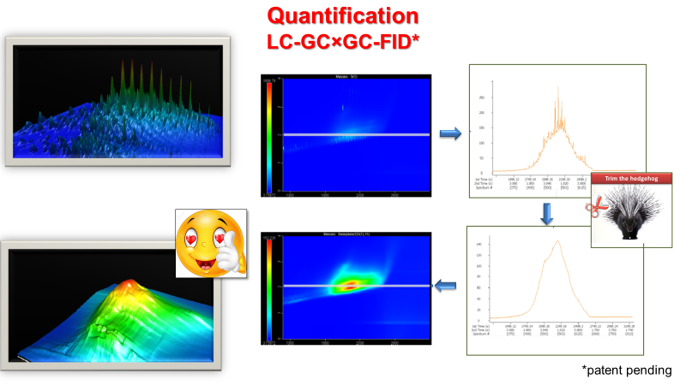
MOSH & MOAH: Analytical Determination
EXTRACTION/SAPONIFICATION
PURIFICATION
LC-GC-FID
Ideal profile
How to support the interpretation?
GC×GC
MOSH & MOAH
& sub-classes quantification in 2D
Bauwens, G., Panto, S., & Purcaro, G. (2021). Mineral oil saturated and aromatic hydrocarbons quantification: Mono- and two-dimensional approaches. Journal of Chromatography. A, 1643, 462044.doi:10.1016/j.chroma.2021.462044

Slide 36

MOSH & MOAH: Analytical Determination
EXTRACTION/SAPONIFICATION
PURIFICATION
LC-GC-FID
Ideal profile
How to support the interpretation?
GC×GC
G. Bauwens, L. Barp, G. Purcaro, Validation of the liquid chromatography-comprehensive multidimensional gas chromatography-time-of-flight mass spectrometer/flame ionization detector platform for mineral oil analysis exploiting interlaboratory comparison data, GreenAC (2023) 4 100047

Slide 37
MOSH & MOAH: Analytical Determination
EXTRACTION/SAPONIFICATION
PURIFICATION
LC-GC-FID
Ideal profile
How to support the interpretation?
GC×GC
G. Bauwens, L. Barp, G. Purcaro, Validation of the liquid chromatography-comprehensive multidimensional gas chromatography-time-of-flight mass spectrometer/flame ionization detector platform for mineral oil analysis exploiting interlaboratory comparison data, GreenAC (2023) 4 100047

Slide 38
MOSH & MOAH: Analytical Determination
Sample dilution (e.g., fats and oil)
Working range starting from 10 mg/kg
Max LC loading : 20 mg of fat
LC-GC-FID
EXTRACTION/ENRICHMENT
LC-GC-FID
↑ Sensitivity (2 mg/kg*)
*Depends on the initial content of fat
EXTRACTION/SAPONIFICATION
PURIFICATION
LC-GC-FID
≈ Sensitivity
≈ ↑↓ Accuracy
EXTRACTION/SAPONIFICATION
PURIFICATION
LC-GC×GC-FID
↑ Sensitivity
↑ Accuracy
↑ information
@Agree
Anal. Chem. 2020, 92, 10076−10082

Slide 39

MOSH & MOAH: Analytical Determination
Sample
Preparation
EXTRACTION/SAPONIFICATION
PURIFICATION
LC-GC-FID
Ideal profile
How to support the interpretation?
GC×GC
IMPROVEMENT ON SAMPLE PREP IS STILL NEEDED!

Slide 40






MOSH & MOAH: Analytical Determination
EXTRACTION/SAPONIFICATION
PURIFICATION
LC-GC-FID
JRC Edible oil PT
ISO 20122:2024
Infant Formula
Olive oil sample
Not specifically discussed, but discrepancies TBB/2MN observed from multiple labs
total MOAH referred to TBB was constantly 13 % lower than the one obtained using 2MN.
peak ratio between TBB and 2MN ≤1.25
peak ratio between TBB and 2MN = 1.00
Sample
Preparation
@Agree
Anal. Chem. 2020, 92, 10076−10082

Slide 41
MOSH & MOAH: New Advancements
TBB/2MN: 1.19 ± 0.09
TBB/2MN: 1.05 ± 0.02
Improved !!!
60°C × 30 min
60°C × 30 min
Reduction of the « polarity-based discrimination »
No matter the selected standard, the MOAH concentration would be the same
ISO 20122:2024
Bauwens&Purcaro
TBB/MN= 1.05±0.02
Sample
Preparation
Matrix
Bauwens, G., Purcaro, G., 2024. Improved microwave-assisted saponification to reduce the variability of MOAH determination in edible oils, Analytical Chimica Acta, 1312 342788

Slide 42
MOSH & MOAH: New Advancements
TBB/2MN: 1.19 ± 0.09
TBB/2MN: 1.05 ± 0.02
Improved !!!
120 °C × 20 min
60°C × 30 min
60°C × 30 min
Reduction of the « polarity-based discrimination »
No matter the selected standard, the MOAH concentration would be the same
 | MASE TBB/2MN
Crude palm oil | 0.97 ± 0.01
No matrix | 1.02 ± 0.02
FH Palm Oil | 1.02 ± 0.05
FH Coconut Oil | 1.04 ± 0.02
Rice Bran Oil | 1.05 ± 0.05
Rapeseed Oil | 1.06 ± 0.01
FH Palm Kernel Olein | 1.07 ± 0.02
Coconut Oil | 1.07 ± 0.01
Fish Oil | 1.07 ± 0.02
Refined Palm Oil | 1.07 ± 0.05
Extra virgin olive oil | 1.13 ± 0.01
FH Rapeseed oil | 1.16 ± 0.00
TBB/MN= 1.05±0.01
The method however showed to not be efficient on some high-melting matrices. So, time and temperature were re-optimized
Sample
Preparation
Gorska, A., Ferrara, D., Albendea, P., Cordero, C. E., Purcaro, G., Update on the microwave-assisted saponification conditions for mineral oil hydrocarbons determination in fats and oils, Analyst, 2025,150, 5190-5200

Slide 43

MOSH & MOAH: Analytical Determination
EXTRACTION/SAPONIFICATION
PURIFICATION
LC-GC-FID
LC
LC
Microwave-assisted saponification and extraction (MASE) method
Loss of 20-40% of MOAH
EPOXIDATION
GC-FID
GC-FID
Sample
Preparation
Works rather well but also attacks MOAH due to their double bonds

Slide 44


ROUTINE PURIFICATION METHOD
Purification
Epoxidation performed manually
MOAH RECOVERY (%)
 | PALM OIL |  | SUNFLOWER OIL
 | /2MN | /PYR | /2MN | /PYR
MCPBA (n_{PO}=2, n_{SFO}=1) | *65% (± 21%) | *38% (± 7%) | 98% | 56%
PER AC C6 (n=3) | 177% (± 36%) | 105% (± 36%) | 146 (± 12%) | 124 (± 58%)
PER AC CHCl₃ (n=3) | 79% (± 29%) | 61% (± 29%) | 61% (± 19%) | 47% (± 19%)
Oils spiked with 15 mg/kg (*7.5 mg/kg) of a mixture of of Gravex (very volatile MOAH), SN100 Aromatic Extract (mid volatility), SN500 Aromatic Extract (heavy fraction)
Sample
Preparation
Low and Variable Recoveries!!!

Slide 45

MOSH & MOAH: New Advancements
ISO 20122:2024 Vegetable oils — Determination of mineral oil saturated hydrocarbons (MOSH) and aromatic hydrocarbons (MOAH) with online coupled HPLC-GC-FID analysis — Method for low limit of quantification
Saponification + L/L extraction (C6)
SPE cleaning (only if needed)
Epoxidation (only if needed)
HPLC-GC-FID analysis
The issue with the current purification method for MOAH (i.e., epoxidation) is that it relies on a non-selective chemical reaction which also attacks MOAH.
It would therefore be relevant to develop a purification method which is not based on a chemical reaction anymore.
Sample
Preparation
Notes:
POH Polyoligomeric hydrocarbons

Slide 46
MOSH & MOAH: New Advancements
ISO 20122:2024 Vegetable oils — Determination of mineral oil saturated hydrocarbons (MOSH) and aromatic hydrocarbons (MOAH) with online coupled HPLC-GC-FID analysis — Method for low limit of quantification
Saponification + L/L extraction (C6)
SPE cleaning (only if needed)
Epoxidation (only if needed)
HPLC-GC-FID analysis
Saponification + L/L extraction (C6)
HPLC purification
HPLC-GC×GC-FID analysis
Sample
Preparation
Notes:
POH Polyoligomeric hydrocarbons

Slide 47


MOSH & MOAH: New Advancements
Saponification + L/L extraction (C6)
HPLC purification
HPLC-GC×GC-FID analysis
Allure Silica (250 mm × 2.1 mm i.d. × 5 μm d_{p}, 60 Å (Restek)
HPLC
GC(×GC)
C6/DCM gradient 1
Non-purified oil extract
(after saponification)
MOAH
MOSH
Sample
Preparation
Gradient 1: 0 min 100% C6; 1.5–6 min 65% C6 35% DCM at 0.3 mL/min
Notes:
POH Polyoligomeric hydrocarbons

Slide 48
MOSH & MOAH: New Advancements
Saponification + L/L extraction (C6)
HPLC purification
HPLC-GC×GC-FID analysis
Allure Silica (250 mm × 2.1 mm i.d. × 5 μm d_{p}, 60 Å (Restek)
HPLC
GC(×GC)
C6/DCM gradient 1
C6/DCM gradient 2
MOAH
MOSH
Sample
Preparation
Gradient 1: 0 min 100% C6; 1.5–6 min 65% C6 35% DCM at 0.3 mL/min
Gradient 2: 0 min 100% C6; 1.5–14.5 min 98% C6 2% DCM; 14.5–23 min 95% C6 5% DCM at 0.3 mL/min
Notes:
POH Polyoligomeric hydrocarbons

Slide 49
MOSH & MOAH: New Advancements
Saponification + L/L extraction (C6)
HPLC purification
HPLC-GC×GC-FID analysis
Allure Silica (250 mm × 2.1 mm i.d. × 5 μm d_{p}, 60 Å (Restek)
HPLC
GC(×GC)
C6/DCM gradient 1
C6/DCM gradient 2
Purified MOAH
Sample
Preparation
Gradient 1: 0 min 100% C6; 1.5–6 min 65% C6 35% DCM at 0.3 mL/min
Gradient 2: 0 min 100% C6; 1.5–14.5 min 98% C6 2% DCM; 14.5–23 min 95% C6 5% DCM at 0.3 mL/min
Notes:
POH Polyoligomeric hydrocarbons

Slide 50














MOSH & MOAH: New Advancements
Saponification + L/L extraction (C6)
HPLC purification
HPLC-GC×GC-FID analysis
Very good removal of carotenoids and squalene
Other terpenoids are less well removed
Sample
Preparation
Notes:
POH Polyoligomeric hydrocarbons

Slide 51

MOSH & MOAH: New Advancements
Saponification + L/L extraction (C6)
HPLC purification
HPLC-GC×GC-FID analysis
Very good removal of carotenoids and squalene
Epoxidation
mCPBA performic acid
82%± 10% 71 ± 16%
MOAH Recovery LC Purification:
94% ± 2%
Other terpenoids are less well removed
Notes:
POH Polyoligomeric hydrocarbons

Slide 52

MOSH & MOAH: New Advancements
Saponification + L/L extraction (C6)
HPLC purification
HPLC-GC×GC-FID analysis
The LC purification method also allows to separate and quantify MOAH based on their number of aromatic rings.
Sample
Preparation
Notes:
POH Polyoligomeric hydrocarbons

Slide 53
S
Select direct analytical technique
I
Integrate analytical processes and operations​
G
Generate as little waste as possible​
N
Never waste energy​
LC-GC-FID, no MS
I
Implement automation and miniaturization​
Partially Automated
F
Favor reagents from renewable sources​
GREEN CHEMISTRY
GREEN ANALYTICAL CHEMISTRY
I
Increase safety for the operator​
Online method
C
Carry out in-situ measurements​
A
Avoid derivation​
N
Note minimal sample number and size​
C
Choose multi‑analyte or multi‑parameter methods​
UCM
E
Eliminate or replace toxic reagents​
Notes:
1. S Direct analytical techniques should be applied to avoid
sample treatment.
2. N Minimal sample size and minimal number of samples are
goals.
3. C In situ measurements should be performed.
4. I Integration of analytical processes and operations saves
energy and reduces the use of reagents.
5. I Automated and miniaturized methods should be selected.
6. A Derivatization should be avoided.
7. G Generation of a large volume of analytical waste should be
avoided and proper management of analytical waste should
be provided.
8. C Multi-analyte or multi-parameter methods are preferred
versus methods using one analyte at a time.
9. N The use of energy should be minimized.
10. F Reagents obtained from renewable source should be preferred.
11. E Toxic reagents should be eliminated or replaced.

Slide 54

MOSH & MOAH: Analytical Determination
Sample dilution (e.g., fats and oil)
Working range starting from 10 mg/kg
Max LC loading : 20 mg of fat
LC-GC-FID
EXTRACTION/ENRICHMENT
LC-GC-FID
↑ Sensitivity (2 mg/kg*)
*Depends on the initial content of fat
EXTRACTION/SAPONIFICATION
PURIFICATION
LC-GC-FID
≈ Sensitivity
≈ ↑↓ Accuracy
↑ Sensitivity
↑ Accuracy
↑ information
EXTRACTION/SAPONIFICATION
PURIFICATION
LC-GC×GC-FID
EXTRACTION/SAPONIFICATION
↑ Sensitivity
↑ ↑ Accuracy
↑ information
LC-PURIFICATION
LC-GC×GC-FID
@Agree
Anal. Chem. 2020, 92, 10076−10082

Slide 55




CONCLUSION
MOSH & MOAH: How green are we?
Analytical evolution
Sensitivity ; Accuracy ; information

Slide 56




https://www.extech2026.uliege.be/cms/c_20456371/en/extech-2026
JOIN
6-9 JULY 2026
GEMBLOUX AGRO-BIO TECH
BECAUSE SCIENCE IS THE KEY
https://www.extech2026.uliege.be

Slide 57













Thank you for the attention
Research team
Giorgia Purcaro
Sophie Vancraenenbroeck
Aleksandra Gorska
Damien Pierret
Damien Eggermont
Carlo Bellinghieri
Donatella Ferrara
Nicola Ruin

